Slide 1
Qualifications analysis

Slide 2
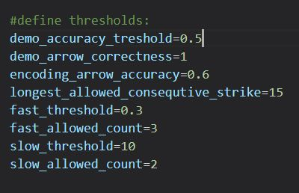
Original qualifications
Test overall accuracy >=0.61
OR
Layer 1 accuracy , layer 2 accuracy, layer 3 accuracy >=0.75

Slide 3
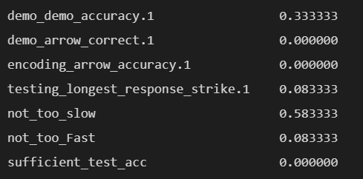
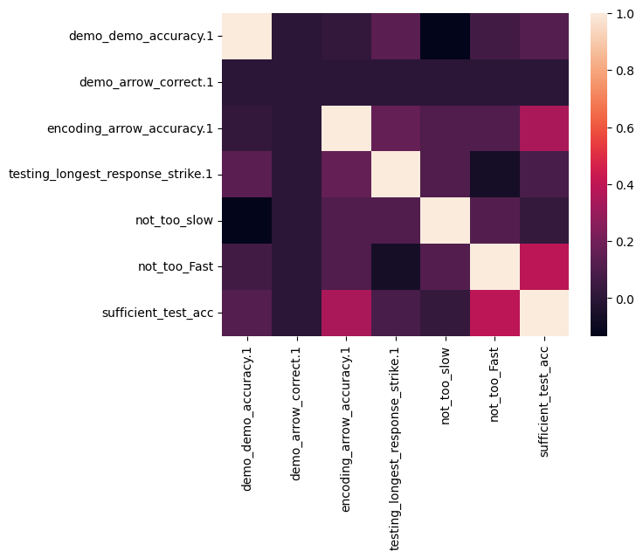
Percentage of occurrences of false in one qualification and true in sufficient test accuracy
Correlation between all qualification types

Slide 4
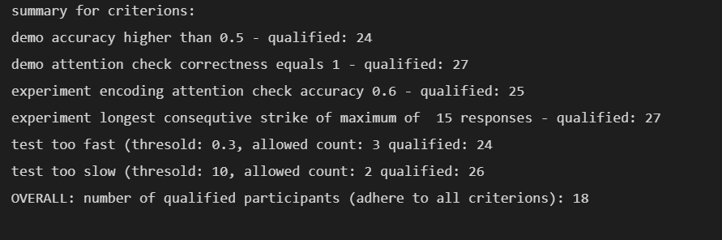
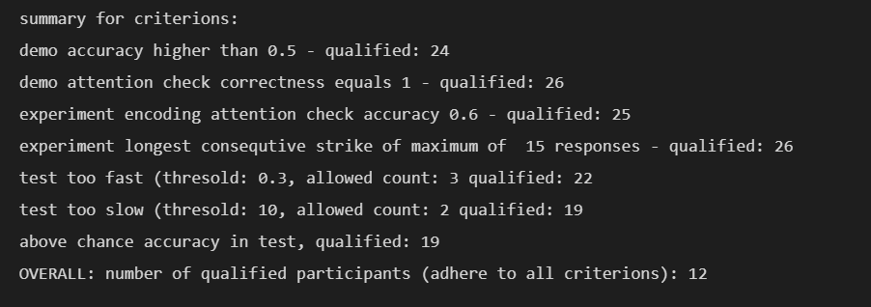
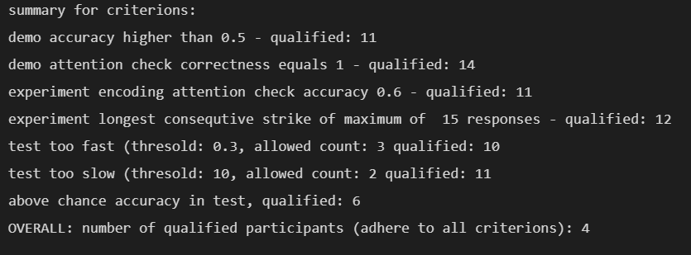
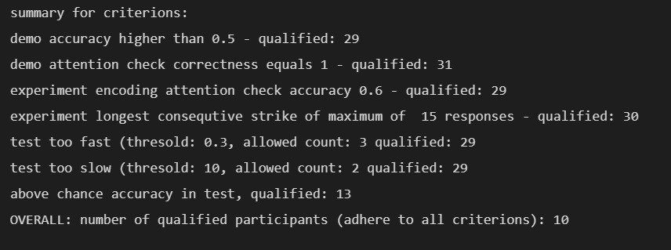
Same day
24 hours
One week

Slide 5
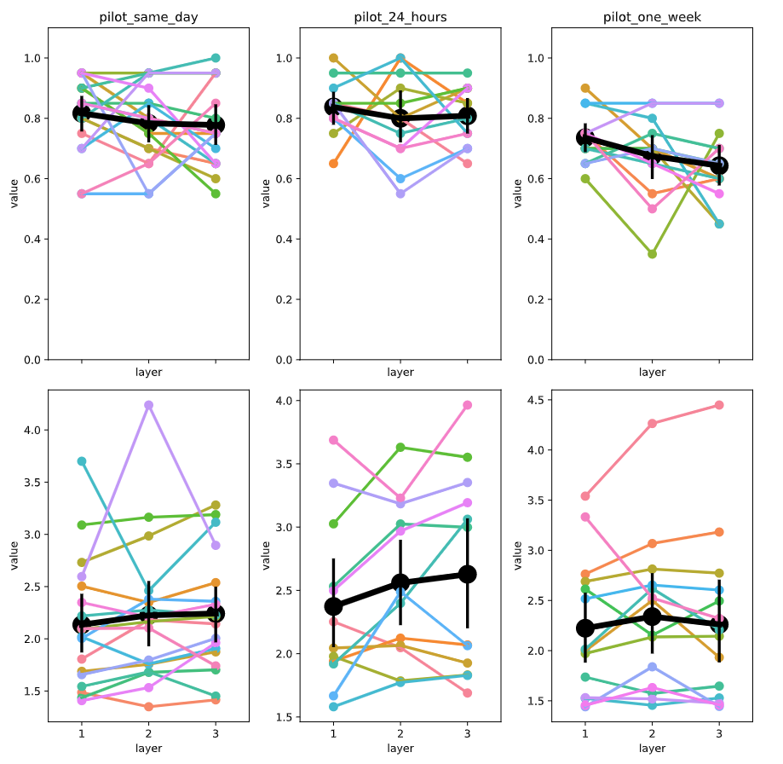
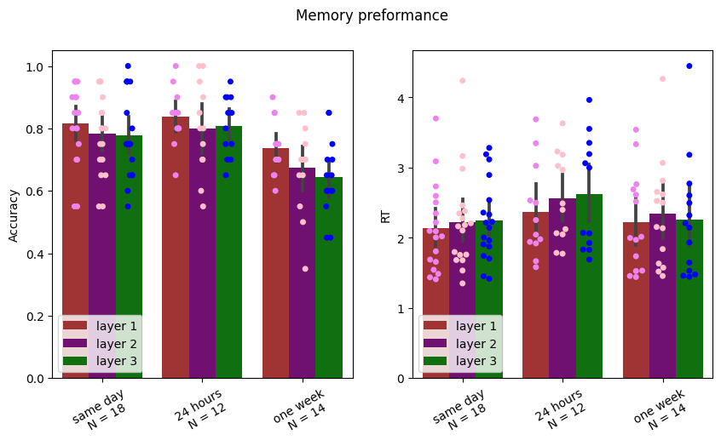
Results

Slide 6
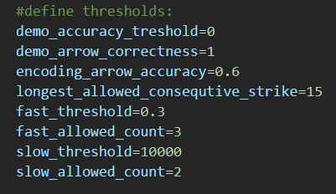
New qualifications
Test overall accuracy >=0.55
OR
Layer 1 accuracy , layer 2 accuracy, layer 3 accuracy >=0.75

Slide 7
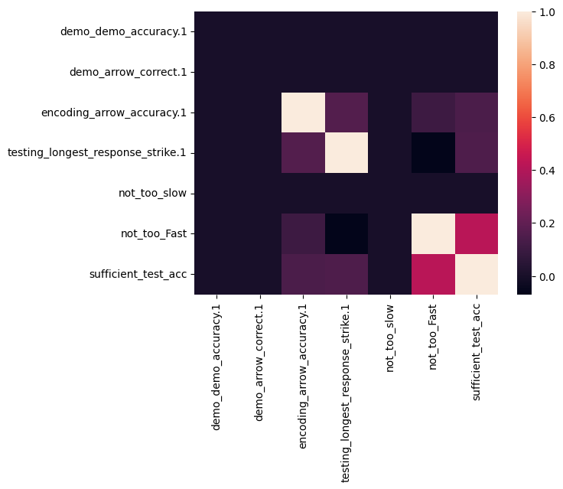
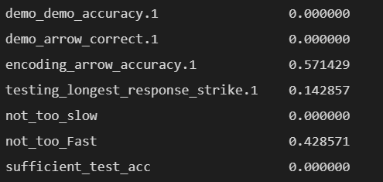
Percentage of occurrences of false in one qualification and true in sufficient test accuracy
Correlation between all qualification types

Slide 8
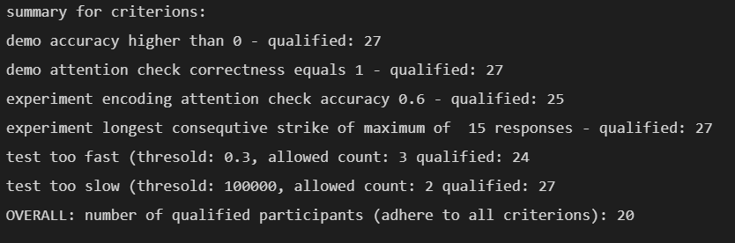
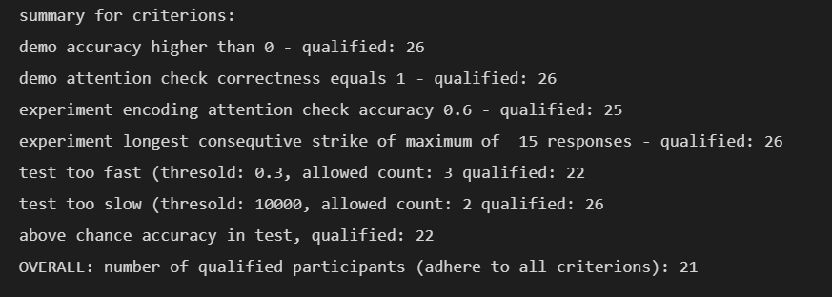
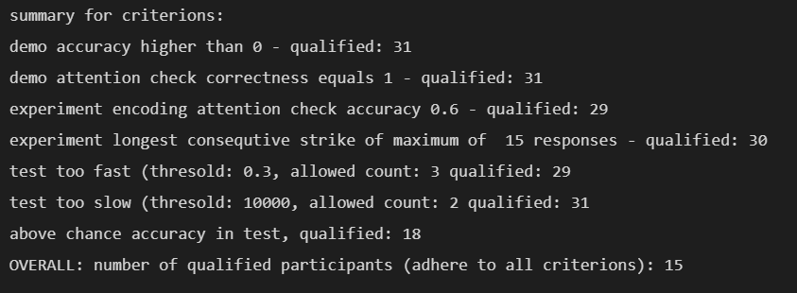
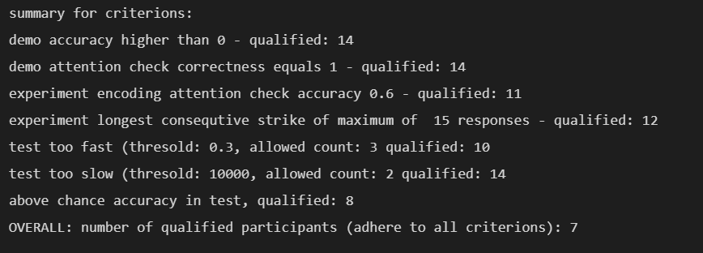
Same day
24 hours
One week

Slide 9
